Slide 1

BCSE-0611 Application & Data Security
Dr. Arvind Prasad
Department of CEA
GLA University, Mathura

Slide 2
Mobile Security

Slide 3
Introduction to Mobile Security
Mobile Security refers to protecting smartphones, tablets, and other portable devices from threats such as data theft, malware, unauthorized access, and network attacks.
Why It Matters:
  Mobile devices store personal, financial, and corporate data.
  High risk of loss or theft.
  Frequent internet connectivity → exposure to phishing, malware, and network attacks.
  Use of third-party apps can introduce vulnerabilities.
Common Threats:
  Phishing Attacks – fake apps or links stealing credentials.
  Malware & Spyware – malicious code stealing or tracking user data.
  Data Leakage – via insecure apps or permissions.
  Network Attacks – man-in-the-middle, Wi-Fi spoofing.
  Device Theft – physical compromise of data.

Slide 4
Why Focus on Android Security
Why Android?
  Over 70% of mobile devices run Android.
  Open-source nature makes it flexible but more exposed to malicious modifications.
  Allows installation from unverified sources (APK sideloading).
  Highly customizable, leading to fragmentation and inconsistent security patches.
Key Security Goals:
  Confidentiality: Protect user data.
  Integrity: Prevent unauthorized modification.
  Availability: Ensure secure and stable operation.
  Authenticity: Verify apps and sources.
  Isolation: Contain the impact of malicious apps.

Slide 5
Android Architecture Overview
Five Key Layers:
  Applications
  Application Framework
  Android Runtime
  Platform Libraries
  Linux Kernel

Slide 6
Android Security Overview
Android Security uses a multi-layered defense-in-depth model — meaning each layer of the architecture contributes to overall protection.
Main Security Mechanisms:
  Sandboxing: Isolates apps from each other.
  Permissions System: User consent for sensitive operations.
  Google Play Protect: Scans apps for malicious behavior.
  SELinux: Enforces strict access control at the kernel level.
  Regular Security Patches: Fix known vulnerabilities.
Notes:
SELinux (Security-Enhanced Linux) is a security module built into the Linux kernel that enforces mandatory access control (MAC) policies.
Sandboxing ensures every app lives in its own secure box, isolated by the Linux kernel and controlled by the OS — protecting user data and the system from malicious interference. Android assigns a unique Linux User ID (UID) to each app when it’s installed.
The Linux Kernel uses this UID to separate app processes and data — just like different users on a Linux system.
One app’s files are stored in /data/data/<app_package> and cannot be accessed by another app.

Slide 7
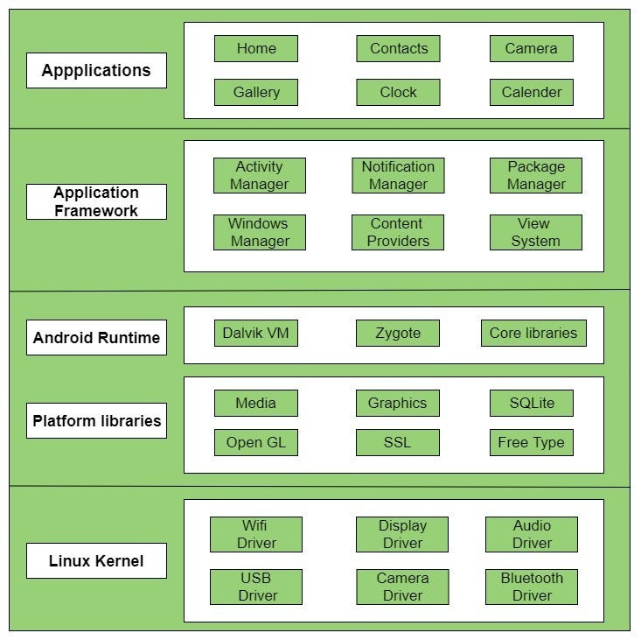
Architecture
Notes:
SELinux (Security-Enhanced Linux) is a security module built into the Linux kernel that enforces mandatory access control (MAC) policies.
Zygote is a system process in Android Runtime (ART) that acts as the parent process for all Android apps.
When the Android system boots, it starts the Zygote process.
Zygote preloads common libraries, frameworks, and resources (like UI elements, core classes, etc.).

Slide 8
Applications Layer
Description:
  The topmost layer where user and system apps run (Home, Camera, Gallery, Clock, etc.).
  Apps communicate through defined interfaces — no direct hardware or kernel access.
Security Role:
  Sandboxing: Each app runs in an isolated environment.
  Permissions: Apps request user approval to access resources.
  App Signing: Ensures integrity and authenticity of applications.

Slide 9
Application Framework Layer
Description:
  Provides reusable APIs and system services for app developers.
  Components:
    Activity Manager
    Notification Manager
    Content Providers
    Package Manager
    Window Manager
    View System
Security Role:
  Controls data sharing through Content Providers.
  Enforces permissions and policy checks before granting resource access.
  Manages secure inter-process communication (IPC).

Slide 10
Android Runtime Layer
Description:
  Core part of Android responsible for executing applications.
  Contains:
    ART (Android Runtime) — executes app bytecode.
    Zygote — preloads system classes for faster app launch.
    Core Libraries — provide Java-based system functionalities.
Security Role:
  Runtime Permissions: Apps request access dynamically.
  Memory Management: Prevents buffer overflows and memory corruption.
  Code Verification: Ensures apps run safely within a managed environment.

Slide 11
Platform Libraries Layer
Description:
  Includes essential C/C++ libraries for system operations (Media, Graphics, SQLite, SSL, FreeType, OpenGL).
Security Role:
  SSL/TLS: Secure network communication (HTTPS).
  SQLite: Manages secure, isolated data storage.
  Library Hardening: Prevents exploits in native code.

Slide 12
Linux Kernel Layer
Description:
  The foundation of Android OS; manages process, memory, and hardware.
  Includes hardware drivers (Wi-Fi, Camera, Bluetooth, Audio, USB).
Security Role:
  Process Isolation: Each app has a unique user ID (UID).
  SELinux (Security-Enhanced Linux): Enforces mandatory access control.
  Hardware Abstraction: Prevents apps from directly accessing device drivers.
  Secure Boot & Verified Boot: Ensure OS integrity from startup.

Slide 13
Summary — Security by Design
Layer | Key Security Features
Applications | Sandboxing, App Signing, Permissions
Framework | Access Control, Data Protection
Runtime | Code Verification, Memory Safety
Libraries | Secure Communication, Encrypted Storage
Kernel | SELinux, Process Isolation, Hardware Protection
Notes:
Security-Enhanced Linux

Slide 14
Linux Kernel
The core of Android OS — built on the Linux kernel.
Handles low-level system services like process management, memory management, power management, device drivers, and security.
Provides hardware abstraction — meaning apps don’t access hardware directly (e.g., camera, Wi-Fi, Bluetooth).
Uses process isolation and user-based permissions (UIDs) to sandbox apps.
Implements SELinux (Security-Enhanced Linux) for enforcing strict access control. Defines strict rules about what each app or system component is allowed to do. Even if an app is hacked, SELinux prevents it from accessing things it shouldn’t.
Notes:
Hardware Abstraction means creating a middle layer between the device’s physical hardware (camera, GPS, Wi-Fi, sensors, etc.) and the software (apps).

Slide 15
Libraries
A set of C/C++ libraries that provide key functionalities to higher layers.
These libraries are used by the Android Runtime and Application Framework.
Examples:
  OpenGL ES: Graphics rendering
  SQLite: Database storage
  WebKit: Browser engine
  SSL: Secure network communication
  Media Framework: Audio/video playback and recording

Slide 16
Android Runtime (ART)
This layer runs and manages Android applications.
ART (Android Runtime) replaced the older Dalvik VM.
Each app runs in its own process and sandboxed environment.
ART compiles app code Ahead-of-Time (AOT) into native machine code, improving performance.
Includes core Java libraries that provide basic Android functionality.
Handles memory management, garbage collection, and runtime permissions.

Slide 17
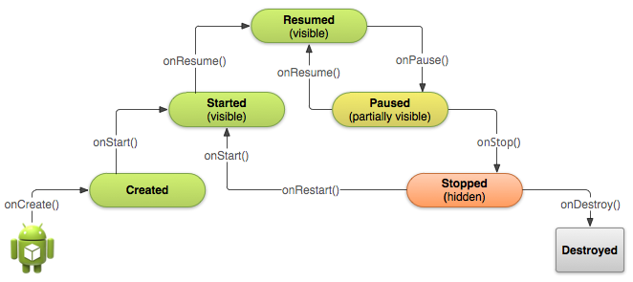
Activity Life Cycle
Notes:
17
onCreate() → Initializes the activity; sets up UI and essential components.
onStart() → Makes the activity visible to the user (not yet interactive).
onResume() → Brings the activity to the foreground and ready for user interaction.
onPause() → Called when another activity overlaps; pause ongoing tasks or animations.
onStop() → Activity becomes fully hidden; release resources or save data.
onRestart() → Called when returning to the activity after being stopped.
onDestroy() → Cleans up resources before the activity is destroyed.

Slide 18
Android Activity Lifecycle
onCreate()
→ Called when the activity is first created.
→ Initialize the UI, bind views, set up essential components, restore state.
onStart()
→ Activity becomes visible to the user (but not yet in the foreground).
→ Prepare UI-related updates.
onResume()
→ Activity moves to the foreground and becomes interactive.
→ Start animations, listeners, or any processes that need to run while visible.
onPause()
→ Another activity is partially covering this one.
→ Pause ongoing tasks, animations, sensors; commit unsaved changes.

Slide 19
Android Activity Lifecycle
onStop()
→ Activity is completely hidden.
→ Release heavy resources, unregister receivers, save persistent data.
onRestart()
→ Called when the activity transitions from stopped back to started.
→ Re-initialize components released in onStop().
onDestroy()
→ Final cleanup before the activity is destroyed.
→ Release all remaining resources.

Slide 20
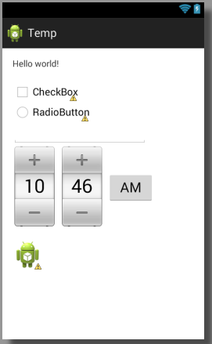
Views
A building block for UI components
Responsible for drawing and event handling
Each View has an id
findViewById(int)
Text box, check box, radio button, time picker, and image view
Notes:
20

Slide 21
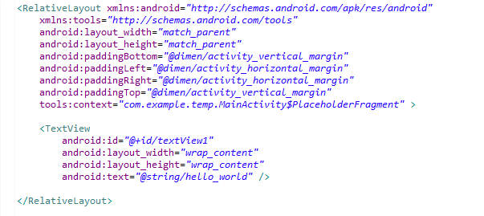
XML
Eclipse IDE
Uses XML files to set up the mobile application
Android Layout File
Notes:
21

Slide 22
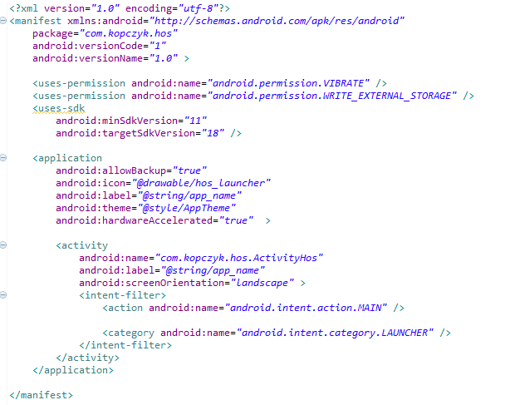
XML - Android Manifest
Contains properties of the application
Permissions, SDK, Icon, Activities
Android Manifest File
Notes:
22

Slide 23
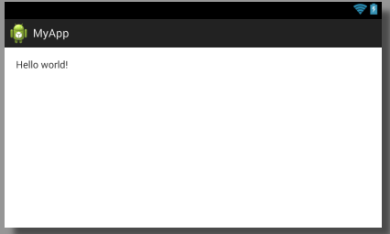
XML - Layout
Defines the layout of the Activity
Set View id values
Could achieve the same results through java code
Android Layout File
Notes:
23

Slide 24
Input Events
OnClickListener
OnLongClickListener
OnFocusChangeListener
OnKeyListener
OnTouchListener
OnCreateContextMenuListener
Notes:
24

Slide 25
Permission
Allows developers to use security features
Provides additional capabilities to consumers that otherwise would be impossible
“A central design point of the Android security architecture is that no application, by default, has permission to perform any operations that would adversely impact other applications, the operating system, or the user”
Notes:
25

Slide 26
Permission
When an Application is installed the consumer must accept the permissions requested by an application
Permissions are defined in the Manifest file
Notes:
26

Slide 27
Permission
Facebook Messenger
  Identity
  Contacts/Calendar
  Location
  SMS
  Phone
  Photos/Media/Files
  Camera/Microphone
  Wi-Fi Connection Information
  Device ID & Call Information
Angry Birds
  Identity
  In-app purchases
  Location
  Photos/Media/Files
  Wi-Fi Connection Information
  Device ID & Call Information
Notes:
27

Slide 28
Rooting (Android)
Rooting is the process of gaining privileged (root) access to an Android device’s operating system.
It allows the user (or attacker) to modify system files, install unauthorized apps, and bypass built-in security controls.
Pros (for advanced users):
  Full control over device and OS.
  Custom ROMs, performance tuning, deep customization.
Security Risks:
  Removes Android’s built-in sandboxing and app isolation.
  Increases risk of malware, data theft, and system compromise.
  Voids warranty and disables secure apps (e.g., banking, UPI).
Notes:
A Custom ROM is a modified version of the Android operating system that replaces the original (stock) firmware installed by the device manufacturer. To get the latest Android version when the manufacturer stops official updates.

Slide 29
Jailbreaking (iOS)
Jailbreaking is the iOS equivalent of rooting — it removes Apple’s software restrictions to gain access to the iPhone’s file system and install non-App Store apps.
Pros:
  More customization, third-party app installation.
Security Risks:
  Disables iOS security layers (code signing, sandboxing).
  Makes device vulnerable to malware and remote exploits.
  Sensitive apps (like banking) often refuse to run on jailbroken devices.

Slide 30
Rooting vs. Jailbreaking:
Aspect | Rooting (Android) | Jailbreaking (iOS)
Purpose | Gain root access for customization, removing OEM limits. | Bypass Apple’s restrictions to install non-App Store apps.
OS | Android (Linux-based) | iOS (Apple)
Method | Exploits OS vulnerabilities to unlock root access. | Uses iOS exploits to disable Apple’s code-signing checks.
Security Impact | Breaks app sandboxing, allows malware full system access. | Disables iOS security layers (sandboxing, app signing).
Official Support | Not allowed by Google; voids warranty. | Not allowed by Apple; voids warranty.

Slide 31
Preventive Measures:
Avoid unauthorized system modifications or privilege escalation tools.
Use only official app marketplaces and verified updates.
Apply security patches regularly.
Enable device integrity checks (e.g., verified boot, integrity attestation).
Use enterprise policies or mobile device management (MDM) to block altered devices.
Educate users about the risks of unrestricted system access.
Notes:
Integrity Attestation is a mechanism that allows apps or remote servers to verify the integrity and security state of a device before trusting it. Prevents sensitive apps (banking, corporate, payment) from running on compromised devices.

Slide 32
Mobile Application Security Vulnerabilities — OWASP Top 10
The OWASP (Open Web Application Security Project) Mobile Top 10 lists the most critical security risks found in mobile applications.
It helps developers, testers, and security analysts identify and mitigate common weaknesses in Android and iOS apps.

Slide 33
M1 – Improper Platform Usage
Occurs when a mobile app misuses platform-specific features or permissions, or fails to use security controls properly.
Examples:
  Misusing Android intents or iOS URL schemes.
  Failing to enforce permissions (e.g., camera, location).
  Ignoring platform security features like Keychain or Keystore.
Mitigation:
  Follow official platform security guidelines.
  Use Android Permissions Model and KeyStore API properly.
  Disable exported components unless required.
Notes:
Intents are messages used in Android to start activities, send data, or communicate between apps.
If developers don’t properly secure intents, other apps can intercept, modify, or trigger them.
URL Schemes in iOS let apps communicate using custom URLs (e.g., mybank://transfer).

Slide 34
M2 – Insecure Data Storage
Sensitive data is stored unencrypted or insecurely on the device’s file system, shared preferences, or databases.
Examples:
  Storing passwords, tokens, or personal info in plain text.
  Saving sensitive logs or caches that can be read by other apps.
Mitigation:
  Use encryption for local data.
  Store secrets only in Secure Enclave/KeyStore.
  Avoid writing sensitive data to logs or external storage.
Notes:
Secure Enclave (iOS) and Android Keystore are hardware-backed security modules that safely store sensitive information like passwords, cryptographic keys, and tokens.
A hardware-backed security module is a dedicated chip or processor inside a mobile device that performs security-critical operations (like encryption, key storage, and authentication) in a physically isolated environment — separate from the main operating system and apps.

Slide 35
M3 – Insecure Communication
Occurs when the app transmits sensitive data over unsecured or poorly configured network connections.
Examples:
  Using HTTP instead of HTTPS.
  No SSL/TLS certificate validation.
  Allowing weak ciphers or old protocols.
Mitigation:
  Always use HTTPS/TLS 1.2+.
  Implement certificate pinning.
  Validate SSL certificates strictly.
  Never transmit sensitive data in URLs or GET parameters.
Notes:
Certificate pinning is a cybersecurity practice where a specific certificate or public key is “pinned” to an application or browser, allowing only the pinned certificate to establish a secure connection with the server. When a mobile app or browser attempts to communicate with a server, it checks whether the server’s certificate matches the pinned certificate. If it doesn’t, the connection is blocked, effectively reducing the risk of an attack.

Slide 36
M4 – Insecure Authentication
Weak or flawed authentication mechanisms that allow attackers to bypass login or impersonate users.
Examples:
  Relying only on device identifiers (IMEI, MAC).
  Poor session management (no expiry, predictable tokens).
  No MFA (Multi-Factor Authentication).
Mitigation:
  Use strong multi-factor authentication (MFA).
  Implement secure session tokens and expiry mechanisms.
  Avoid storing credentials locally.
  Enforce server-side authentication checks.
Notes:
IMEI-International Mobile Equipment Identity

Slide 37
M5 – Insufficient Cryptography
Using weak, outdated, or incorrect cryptographic algorithms to protect data.
Examples:
  Using MD5/SHA-1 instead of modern algorithms.
  Hardcoding cryptographic keys in source code.
  Poor random number generation.
Mitigation:
  Use proven, up-to-date algorithms (AES-256, SHA-256).
  Use KeyStore/Keychain for key management.
  Never hardcode keys or credentials in the app.
  Use hardware-backed cryptography if available.
Notes:
Both Android KeyStore and iOS Keychain are secure storage systems provided by the OS for managing cryptographic keys and sensitive credentials (like passwords, tokens, certificates, etc.).
They ensure that keys never leave the secure hardware and are accessible only to the authorized app.

Slide 38
M6 – Insecure Authorization
Flawed implementation of access control that allows users to access data or functionality beyond their privileges.
Examples:
  A user modifying an API request to access another user’s records.
  Missing server-side role validation.
Mitigation:
  Enforce server-side authorization checks.
  Use Role-Based Access Control (RBAC).
  Validate every request against user privileges.

Slide 39
M7 – Client Code Quality Issues
Poor coding practices such as unhandled exceptions, insecure logic, or buffer overflows in the client-side code.
Examples:
  Lack of input validation in native code (C/C++).
  Debug code left in production.
Mitigation:
  Follow secure coding standards.
  Perform static and dynamic code analysis (SAST/DAST).
  Use safe functions and proper exception handling.
Notes:
SAST - Static Application Security Testing)

Slide 40
M8 – Code Tampering
Attackers modify or repackage the app’s code (APK/IPA) to add malicious functionality.
Examples:
  Reverse-engineering and injecting malware into a legitimate app.
  Removing license verification or security checks.
Mitigation:
  Implement code signing and integrity verification.
  Use runtime integrity checks and tamper detection.
  Obfuscate code to make reverse engineering harder.
Notes:
IPA stands for iOS App Store Package (or iPhone Application Archive).
APK stands for Android Application Package.

Slide 41
M9 – Reverse Engineering
Attackers decompile or analyze the app’s binary to extract sensitive information or understand its logic.
Examples:
  Using tools like APKTool, JADX, or IDA Pro to view source code.
  Extracting API keys or encryption logic.
Mitigation:
  Use code obfuscation (e.g., ProGuard, R8).
  Encrypt critical strings and resources.
  Store secrets on secure servers, not in the app.

Slide 42
M10 – Extraneous Functionality
Extraneous functionality are functions or secrets hidden inside the app (like test code or debug endpoints) that expose internal functions or data.
Examples:
  Debug logs, test APIs, admin panels left in production.
  Hardcoded backdoor credentials.
Mitigation:
  Remove debug and test code before release.
  Conduct security reviews and penetration testing.
  Enforce secure deployment practices.

Slide 43
Summary Table
ID | Vulnerability | Core Risk | Key Mitigation
M1 | Improper Platform Usage | Misuse of OS features | Follow platform security APIs
M2 | Insecure Data Storage | Data leakage | Encrypt local data
M3 | Insecure Communication | MITM attacks | Enforce HTTPS & TLS
M4 | Insecure Authentication | Account takeover | Use MFA & secure sessions
M5 | Insufficient Cryptography | Weak encryption | Use modern crypto algorithms
M6 | Insecure Authorization | Privilege escalation | Server-side access control
M7 | Client Code Quality | Memory corruption | Secure coding & code review
M8 | Code Tampering | Repackaged malware | Code signing & integrity check
M9 | Reverse Engineering | Logic exposure | Obfuscation & encryption
M10 | Extraneous Functionality | Hidden backdoors | Remove debug/test code

Slide 44
Mobile APK Penetration Testing
What is Mobile APK Penetration Testing?
A simulated cyber attack against an Android Application Package (APK) conducted by authorized security professionals to identify and exploit security vulnerabilities.
Key Mindset
Authorized & Legal: Always obtain explicit permission before testing
Simulates Real Attackers: Use same tools/techniques as malicious hackers
Goal-Oriented: Focus on business impact and risk
Comprehensive: Test both client (APK) AND server components

Slide 45
Primary Legal and Ethical Risks during Mobile APK Penetration Testing
Testing without written authorization may violate laws (e.g., Computer Misuse or Cybercrime Acts).
Accessing live user data breaches privacy and data protection regulations (e.g., GDPR).
Risk of unauthorized data exposure or system disruption during testing.

Slide 46
Recommended Safeguards during Testing during Mobile APK Penetration Testing
Use a staging or test environment instead of production systems.
Mask any sensitive or personal data encountered.
Maintain detailed logs and communication with the client to ensure transparency and accountability.

Slide 47
Primary Legal and Ethical Risks while Mobile APK Penetration Testing
Testing without written authorization may violate laws (e.g., Computer Misuse or Cybercrime Acts).
Accessing live user data breaches privacy and data protection regulations (e.g., GDPR).
Risk of unauthorized data exposure or system disruption during testing.

Slide 48
Testing Environment & Tooling
Essential Setup
  Android Studio & SDK - Official tools, emulators, ADB
  Rooted Device/Emulator - Critical for deep analysis
    Google AVD (Android Virtual Device)
  Intercepting Proxy - Burp Suite or OWASP ZAP
Core Testing Tools
Static Analysis (White-Box)
  Jadx- #1 tool for decompiling to Java/Kotlin
  APKTool - Disassembles to Smali code, allows repackaging
  MobSF - Automated static analysis framework
Dynamic Analysis (Black-Box)
  Frida - Dynamic instrumentation toolkit
  Objection - Runtime exploration (built on Frida)
Advanced Reverse Engineering
  Ghidra/IDA Pro - For analyzing native libraries (.so files)

Slide 49
Testing Process
A.Reconnaissance (pre-test)
B. Static Analysis (offline)
C. Dynamic / Runtime Analysis
D. Tampering & Repackaging
E. Post-Exploitation Checks

Slide 50
A. Reconnaissance (pre-test)
Reconnaissance in cybersecurity is the initial phase of a cyberattack where attackers gather information about a target to identify vulnerabilities and plan an attack. This can be done through passive methods, which collect data from public sources without direct interaction, or active methods, which involve probing the target's systems directly. The goal is to build a comprehensive profile of the target's network, systems, and potential weaknesses to find the best entry point.
Identify app version, target SDK, permissions.
Get APK: from Play Store (via downloader), from device adb pull /data/app/... or provided by client.
Read app description and functionality to prioritize sensitive flows (auth, payments, storage).

Slide 51
B. Static Analysis (offline)
Unpack APK
  apktool d app.apk -o app_src (resources + smali)
  jadx-gui app.apk (readable Java source)
Manifest analysis
  AndroidManifest.xml: exported components, permissions, intent-filters, allowBackup, debuggable, usesCleartextTraffic.
  Look for android:exported="true", android:debuggable="true", android:allowBackup="true".
Code inspection
  Search for API keys, hardcoded secrets, credentials, weak crypto, insecure URL endpoints.
  Check use of WebView with addJavascriptInterface, loadUrl patterns.
  Check use of insecure crypto (MD5, SHA1, ECB mode, hardcoded keys).

Slide 52
B. Static Analysis (offline)
Resources & assets
  Inspect res/, assets/ for config files, secrets, certificates, .keystore files.
Native libs
  Disassemble .so with Ghidra for logic hidden in native code.
Third-party libs
  Identify outdated libraries with known CVEs.
Build config
  Look for ProGuard/R8 obfuscation presence. If not present, easier to reverse.

Slide 53
C. Dynamic / Runtime Analysis
Dynamic / Runtime Analysis
Install on test device
  adb install -r app.apk
Run and observe logs
  adb logcat — look for leaks, stack traces, tokens printed.
Network interception
  Configure device/emulator to proxy through Burp.
  Install Burp’s CA on device (user or system CA depending on Android API and cert-pinning).
  Test API calls, observe sensitive data in requests/responses (tokens, PII).
Certificate pinning
  If pinning prevents interception, test bypass:
    Patch app (replace okhttp/ssl logic) or use Frida scripts (e.g., frida-ssl-pinning-bypass), or run on rooted device with Xposed module JustTrustMe/SSLUnpinning, or patch Network Security Config.

Slide 54
C. Dynamic / Runtime Analysis
Runtime hooking
  Use Frida to hook functions (e.g., java.crypto, KeyStore calls, WebView methods, auth flow).
  frida -U -f your.package.name -l script.js --no-pause
Input fuzzing & IPC
  Send crafted Intents/Broadcasts to exported components to test parameter handling and privilege escalation.
  Example: adb shell am start -n com.example/.SensitiveActivity --es amount 100000
Local storage checks
  Inspect app storage: /data/data/<pkg>/ (requires root) for databases, shared_prefs, files.
  Check for plaintext tokens, passwords, PII.
Behaviour under rooting/jailbreak
  Test whether app detects rooted devices and how it behaves; check for logic bypasses.

Slide 55
D. Tampering & Repackaging
Repack flow:
  apktool d app.apk
  Modify payload (e.g., add malicious activity or bypass authentication)
  apktool b app_src → output unsigned APK
  Sign APK: apksigner sign --ks mykeystore.jks app_unsigned.apk
  Install and run; observe behavior
Purpose: test anti-tamper, integrity checks, signature checks.

Slide 56
E. Post-Exploitation Checks
If you can perform actions (change PIN, access data), evaluate impact and persistence.
Try to exfiltrate sensitive data, persist background services, or escalate privileges.

Slide 57
Common Vulnerabilities & How to Test / Exploit
1. Exported components
2. Insecure Data Storage
3. Insecure Communication / No TLS or wrong TLS
4. Hardcoded secrets
5. Insecure WebView usage
6. Insufficient authentication and session management
7. Signature / Integrity checks absent
8. Reverse-engineering / Lack of obfuscation
9. Insecure inter-app communication (Intents & URL Schemes)
10. Insecure use of cryptography
Notes:
Exported components (Activities/Services/BroadcastReceivers/ContentProviders) — App components exposed to other apps that, if left unprotected, allow external apps to invoke functionality or read data they shouldn’t..
Insecure WebView usage — Using WebView with unsafe settings (e.g., addJavascriptInterface, enabling JS for untrusted content) that allows XSS or remote code execution.

Slide 58
TLS (Transport Layer Security)
What it is: A cryptographic protocol designed to provide secure communication over a computer network.
Primary Goal: To ensure privacy, data integrity, and authentication between two communicating applications (e.g., a web browser and a server).
Key Features & Benefits
  Encryption: Scrambles data to prevent eavesdropping (confidentiality). Uses a combination of asymmetric encryption (for the handshake) and faster symmetric encryption (for the data transfer).
  Authentication: Uses digital certificates to verify the identity of the server (and optionally the client). This prevents man-in-the-middle attacks.
  Data Integrity: Uses Message Authentication Codes (MACs) to ensure that data sent between client and server is not tampered with or altered in transit.

Slide 59
Intercepting TLS Traffic
TLS is a protocol for setting up and using a cryptographically secured connection between two computer systems, a client and a server.
TLS (Transport Layer Security) interception is the process of decrypting, inspecting, and then re-encrypting secure HTTPS traffic as it passes through a middlebox. This middlebox acts as a "Man-in-the-Middle" (MitM), breaking the end-to-end encryption between a client (e.g., a user's browser) and a server (e.g., google.com).
TLS interception involves capturing obtaining the plain text of an encrypted transport (usually "HTTPS" using TLS (Transport Layer Security) previously/commonly known as SSL (Secure Sockets Layer) ) either by collecting the encrypted stream and decoding it at a later stage, or more conventionally by posing as the sender (to the receiver) and receiver (to the sender). Security researchers refer to this as a man-in-the-middle attack (MITM) when applied without user knowledge. Vendors that supply equipment for this purpose often refer to the capacity as SSL inspection.

Slide 60
The Static Analysis with JADx
JADx is a powerful, open-source tool that decompiles Android DEX files (the compiled bytecode) back into a very readable, high-level Java source code. It's often more accurate and produces cleaner output than many other decompilers.
Step 0: Preparation & Safety First!
  Isolate the Environment: Perform analysis in a virtual machine (e.g., VirtualBox, VMware) that is not connected to your personal or corporate network. Malware can attempt to escape or infect the host system.
  Acquire the Sample: The suspicious APK file will be your sample (e.g., suspicious_app.apk).
  Have JADx Ready: You can use the command-line tool (jadx) or the GUI (jadx-gui). The GUI is excellent for exploratory analysis.

Slide 61
Cont….
Step 1: Initial Reconnaissance with JADx
Open the APK file with jadx-gui. The left panel will show the project structure.
Examine the AndroidManifest.xml:
This is the app's configuration file. It tells you everything the app says it needs to do.
  Package Name: Note the unique identifier (e.g., com.example.fake.cleaner). Is it trying to impersonate a legitimate app?
  Permissions
  Components (Activities, Services, Receivers, Providers):
    Look for exported components ( android:exported="true"), which can be triggered by other apps. This is a common privilege escalation vector.
    Note the main activity (the app's entry point).
Scan the resources/ Folder:
  Look in res/values/strings.xml for hardcoded URLs, IP addresses, passwords, or encryption keys.
  Check other resource files for any embedded configuration data.
Notes:
Activity: A single screen in the app with a user interface that the user can interact with.
Service: A background worker that performs long-running operations without a user interface.
Broadcast Receiver: An event-driven component that listens for and reacts to system-wide or app-wide announcements.
Content Provider: A managed data store that handles shared data and provides a structured interface for other apps to query or modify it.

Slide 62
Cont….
Step 2: Code Analysis - The Hunt for Malicious Logic
This is the core of the analysis. Use the search function (Ctrl+F) extensively.
Search for Indicators of Compromise (IoCs):
  URLs & IPs: Search for "http://", "https://", and IP address patterns. These are often Command & Control (C&C) servers.
  File Paths: Look for references to sensitive files (/data/data/, /sdcard/).
  Suspicious Strings: Search for keywords like:
    "su" (Superuser - rooting)
    "runtime.exec", "ProcessBuilder" (Executing shell commands)
    "getDeviceId", "getSubscriberId" (Hardware identifiers)
    "crypto", "AES", "DES" (Encryption routines, might be for data exfiltration)
    "banking", "paypal", etc. (Targeting specific apps)

Slide 63
Cont….
Analyze the Entry Points:
  Start from the MainActivity (found via the AndroidManifest.xml). Trace the code from onCreate().
  Examine other components:
    Services: Look for long-running background tasks (e.g., onStartCommand). Malware uses these for persistence.
    BroadcastReceivers: See what system events (e.g., BOOT_COMPLETED) trigger the app's code. BOOT_COMPLETED is a classic persistence mechanism.
    ContentProviders: Check for data leakage through improperly secured providers.
Notes:
BOOT_COMPLETED is considered a classic persistence mechanism because it allows an application or malware to automatically restart or remain active whenever the Android device is rebooted, ensuring its continued operation without requiring the user to manually launch it.

Slide 64
Cont….
Understand the Malware's "Kill Chain":
  Dropper/Payload: Is the app downloading and executing another APK? Look for code that uses PackageManager to install apps or DexClassLoader to load external code.
  Data Theft: Is it reading SMS, contacts, or files? Search for ContentResolver queries for content://sms/ or content://contacts/.
  Evasion: Does it check for emulators, rooted devices, or debugging? Look for checks against Build properties, isDebuggerConnected(), or the presence of specific files like /system/bin/su.
  Communication: How does it talk to the C&C server? Analyze the network code, often found in classes with names like NetworkUtils, HttpRequest, or CommandHandler.
Notes:
The Kill Chain breaks down a cyberattack into sequential phases, from early reconnaissance to the final achievement of the attacker's objectives. Understanding each stage helps defenders identify, prevent, and disrupt attacks at various points.
Evasion is the tactic of using techniques to bypass security defenses to avoid detection.

Slide 65
Android Malware analysis dynamic analysis (Sandbox)
Dynamic analysis involves running the malware in an isolated, monitored environment to observe its:
Network communications
File system operations
API calls
System interactions
User interface behavior

Slide 66
Why Dynamic Analysis for Android Malware?
Static analysis can be defeated by:
  Obfuscation (renaming, encryption, packing)
  Native code (C/C++ libraries)
  Runtime loading (DexClassLoader)
  Conditional logic (only activates in specific circumstances)
Dynamic analysis reveals what the malware actually does when executed.

Slide 67
Dynamic Analysis Setup & Sandbox Environments
Step 0: Critical Safety Precautions
⚠️ NEVER run malware on your personal device or primary network!
Isolated Lab Environment:
  Use a dedicated physical machine or virtual machine
  Isolate from your main network (air-gapped or separate VLAN)
  Consider using a "throwaway" Google account if needed
Network Isolation:
  Use a dedicated analysis network
  Consider using InetSim or FakeNet to simulate internet services
  Use firewall rules to prevent accidental C2 callbacks to real victims

Slide 68
Types of Sandboxes
Sandboxing is a security practice that isolates programs or files in a virtual environment to safely analyze them without risking the rest of a system.
1. Local Emulator Sandboxes
  Android Studio Emulator - Official Google emulator
  Genymotion - Commercial, high-performance
  Use Case: Basic dynamic analysis, controlled environments
2. Physical Device Sandboxes
  Rooted Android Phones - Actual hardware with monitoring tools
  Use Case: Bypassing emulator detection, realistic analysis
3. Cloud Sandboxes
  Any.run - Interactive, real-time control
  Joe Sandbox - Enterprise-grade analysis
  Use Case: Quick analysis without local setup
4. Open-Source Sandboxes
  MobSF - All-in-one static + dynamic analysis
  DroidBox - Behavioral analysis focused
  Use Case: Self-hosted, customizable analysis

Slide 69
Reverse-Engineering Obfuscated Applications (jadx, Ghidra)
When reverse-engineering obfuscated applications, the techniques and tools used depend on the platform and nature of the obfuscation. JADX is primarily for Android applications, while Ghidra is a multi-purpose tool for analyzing compiled code
Using JADX for obfuscated Android applications: JADX is a decompiler that converts Android DEX bytecode (the format used by Android apps) into human-readable Java source code.
Common obfuscation challenges
  Renaming: Obfuscators change meaningful class, method, and variable names to short
  String encryption: Important strings, like API keys or URLs, are often encrypted.
  Control flow obfuscation: The code's execution path is intentionally complicated with extra jumps and traps to confuse decompilers.

Slide 70
Reverse-Engineering Obfuscated Applications (jadx, Ghidra)
Using Ghidra for obfuscated applications: Ghidra is a powerful reverse-engineering framework from the NSA for analyzing compiled code across many different CPU architectures. It is used when an application contains native, compiled libraries (e.g., C or C++) which JADX cannot process.
Common obfuscation challenges
  Packed binaries: The binary may be compressed or encrypted to protect it until runtime. You must unpack it first using dynamic analysis or other techniques.
  Control flow flattening: Similar to Java, control flow can be manipulated to make the program's logic hard to follow in Ghidra's disassembly and decompilation views.
  Indirect calls: Instead of calling a function directly, the program may use a complex chain of instructions to calculate the function's address at runtime, making static analysis difficult.
Notes:
Control flow flattening is a code obfuscation technique that transforms a program's original, structured control flow into a flat structure of a single, infinite loop containing a large switch statement.

Slide 71
RAT for Mobile
A Remote Access Trojan (RAT) is a type of malware that grants an attacker administrative-level control over an infected computer or network device.
Like other trojans, a RAT disguises itself as legitimate software to trick users into downloading and installing it. Once the malware is installed, the attacker can operate the compromised machine covertly and without the user's knowledge

Slide 72
How Remote Access Trojans Work
How a RAT works: A RAT infection typically unfolds in three stages:
Infection: The RAT is delivered to the target's device through social engineering tactics, such as phishing emails, malicious links, or bundled downloads with seemingly harmless software.
Installation and backdoor: Once executed by the victim, the RAT installs itself and opens a "backdoor" into the system. It often disguises itself as a legitimate file or service to evade detection by the user and security software.
Command and control: The RAT connects to a command-and-control (C&C) server operated by the attacker. This allows the attacker to issue commands and receive stolen data from the infected device

Slide 73
Countermeasures: How to protect against RATs
Protecting against RATs requires a multi-layered security approach:
Use security software: Keep antivirus and anti-malware software updated and run regular system scans.
Update and patch: Ensure your operating system and all software are kept up to date with the latest security patches to fix vulnerabilities.
Be careful with downloads: Practice caution when opening email attachments or downloading files from unknown or untrusted sources.
Practice safe browsing: Avoid clicking on suspicious links or pop-ups.
Monitor for signs of infection: Watch for signs of a RAT infection, such as unusually high network traffic, a slow computer, or unexplained system changes.

Slide 74
Cloud Security

Slide 75
Introduction to cloud computing
Cloud computing is a model for enabling convenient, on-demand network access to a shared pool of configurable computing resources that can be rapidly provisioned and released with minimal management effort or service provider interaction.
It allows users to access and use resources without needing to own or manage the underlying infrastructure physically.

Slide 76
Key Characteristics
On-Demand Self-Service
  Users can provision computing resources as needed automatically, without human intervention from the service provider.
Broad Network Access
  Services are available over the network and accessed through standard mechanisms (e.g., web browsers, mobile apps, APIs).
Resource Pooling
  Providers use multi-tenancy to serve multiple customers from a shared pool of resources, dynamically allocated based on demand.
Rapid Scalability
  Resources can be scaled up or down according to user needs, appearing unlimited to the consumer.
Measured Service
  Resource usage is monitored, controlled, and reported—enabling pay-as-you-go or metered billing models.
Notes:
Multi-tenancy is a core concept in cloud computing where a single physical or virtual infrastructure (like servers, storage, or applications) is shared by multiple users or organizations (called tenants), while keeping each tenant’s data and configurations logically isolated from others.

Slide 77
Cloud Deployment Models
Public Cloud
  Owned and operated by third-party providers, delivering services over the public internet.
  Example: AWS, Azure, Google Cloud Platform.
  Advantages: Low cost, scalability, maintenance-free.
Private Cloud
  Exclusively used by a single organization; can be hosted internally or externally.
  Advantages: Enhanced security, full control, compliance support.
Hybrid Cloud
  Combines public and private clouds, enabling data and application portability.
  Advantages: Flexibility, optimized performance, disaster recovery options.

Slide 78
Public Cloud Deployment Model
A Public Cloud is a cloud computing model in which computing resources (like servers, storage, and applications) are owned and operated by third-party cloud service providers and Key Characteristics:
Shared Infrastructure: Multiple organizations (tenants) share the same cloud infrastructure.
Pay-as-you-go Model: Users pay only for the resources they consume (e.g., compute hours, storage).
Scalability: Virtually unlimited resources are available on demand.
Accessibility: Services are accessible via the internet from anywhere, anytime.
Maintenance-Free: The cloud provider manages all hardware, software updates, and infrastructure maintenance.
Multi-Tenancy: Resources are dynamically allocated among multiple users securely.
are made available to the general public over the internet.

Slide 79
Private Cloud Deployment Model
A Private Cloud is a cloud computing model where the cloud infrastructure is exclusively used by a single organization. It can be managed internally or by a third-party provider, and it may be hosted on-premises or in a dedicated data center.
Key Characteristics:
Single-Tenant Environment: All computing resources are dedicated to one organization — no sharing with others.
Greater Control: The organization has full control over infrastructure, data, and security policies.
Customization: Infrastructure and services can be tailored to specific business or regulatory needs.
Enhanced Security: Data and resources remain within the organization’s boundaries or under its governance.
Can be On-Premises or Off-Premises: Hosted in the company’s data center or by a trusted third-party provider.

Slide 80
Hybrid Cloud Deployment Model
A Hybrid Cloud is a combination of public and private cloud environments, designed to share data and applications between them.
It enables organizations to leverage the scalability and cost-efficiency of the public cloud while maintaining control and security of critical workloads in the private cloud.
Key Characteristics:
Integration of Environments: Combines private cloud (on-premises) and public cloud (off-premises) infrastructure.
Data and Application Portability: Workloads can move seamlessly between clouds as per business or technical requirements.
Scalable and Flexible: Use private cloud for sensitive operations and public cloud for scaling or high-demand tasks.
Unified Management: Managed through common orchestration tools to monitor and control both environments.

Slide 81
Benefits of Cloud Computing
Cost Efficiency: No capital investment in hardware; pay only for what you use.
Scalability: Easily adjust resources based on demand.
Accessibility: Access data and applications from anywhere.
Performance: High-speed computing with minimal downtime.
Disaster Recovery & Backup: Automatic data backup and replication across data centers.
Innovation Agility: Quick deployment of new applications and services.

Slide 82
Examples of Cloud Service Providers
Provider | Popular Services
Amazon Web Services (AWS) | EC2, S3, Lambda, RDS
Microsoft Azure | Virtual Machines, Azure SQL, Functions
Google Cloud Platform (GCP) | Compute Engine, Cloud Storage, BigQuery
IBM Cloud | Watson AI, Kubernetes Service
Oracle Cloud | Autonomous Database, OCI Compute

Slide 83
Applications of Cloud Computing
Education: Online learning platforms and data management systems.
Healthcare: Electronic health records, telemedicine, and analytics.
Finance: Fraud detection, data security, and scalable transaction systems.
E-commerce: Hosting web apps, managing customer data, and scaling resources.
Research and Development: High-performance computing (HPC) for simulations and modeling.

Slide 84
Types of cloud computing
Infrastructure as a Service (IaaS)
Platform as a Service (PaaS)
Software as a Service (SaaS)

Slide 85
Infrastructure as a Service (IaaS)
IaaS provides the basic building blocks of cloud computing—virtual servers, storage, and networking—on a pay-as-you-go basis.
Users manage operating systems, applications, and runtime, while the provider manages the physical infrastructure.
Examples:
  Amazon Web Services (AWS EC2)
  Microsoft Azure Virtual Machines
  Google Compute Engine (GCE)
Use Case:
  Hosting virtual machines and applications
  Data backup and disaster recovery
  Scalable website hosting
Key Benefits:
  High scalability and flexibility
  Cost-effective (no physical hardware needed)
  Full control over OS and applications

Slide 86
Platform as a Service (PaaS)
PaaS offers a ready-to-use development and deployment environment. Developers can build, test, and deploy software applications without managing the underlying servers, storage, or networking.
Examples:
  Google App Engine
  Microsoft Azure App Services
  Heroku
Use Case:
  Web and mobile app development
  Continuous integration and delivery (CI/CD)
  Building APIs and microservices
Key Benefits:
  Simplifies development workflows
  Reduces coding and infrastructure complexity
  Automatic scalability and updates

Slide 87
Software as a Service (SaaS)
SaaS delivers fully functional applications over the internet. Users simply access the software through a web browser—no installation or maintenance required.
Examples:
  Google Workspace (Gmail, Docs)
  Microsoft 365
  Salesforce CRM
  Dropbox
Use Case:
  Email and collaboration tools
  Customer relationship management (CRM)
  Accounting and office productivity
Key Benefits:
  No need for software installation or updates
  Accessible from anywhere, on any device
  Subscription-based cost model

Slide 88
Summary Table:
Service Model | User Manages | Provider Manages | Example
IaaS | OS, Applications, Data | Servers, Storage, Networking | AWS EC2, Azure VM
PaaS | Applications, Data | OS, Middleware, Infrastructure | Google App Engine
SaaS | Only Usage | Everything (App + Infra) | Gmail, Salesforce

Slide 89
Docker Container Security
Docker containers package applications and dependencies into isolated units. Security ensures these containers cannot be exploited to compromise the system.
Key Security Concepts:
Isolation: Containers should be isolated from each other and the host OS.
Image Security:
  Use trusted base images only.
  Regularly scan images for vulnerabilities (using tools like Trivy, Clair, Anchore).
Least Privilege:
  Run containers as non-root users.
  Limit capabilities and privileges (e.g., via --cap-drop).
Secrets Management: Avoid hardcoding credentials. Use Docker secrets or environment variables securely.
Network Security:
  Restrict open ports and apply network policies.
Runtime Security:
  Monitor containers for unusual activity.

Slide 90
Docker Engine
The Docker Engine is the core component of the Docker platform. It is responsible for building, running, and managing containers on a host system.
Components of Docker Engine:
Docker Daemon (dockerd):
Runs in the background; manages images, containers, networks, and volumes.
Listens to Docker API requests.
Docker CLI (Command-Line Interface): The user-facing tool (docker command) used to interact with the Docker Daemon via REST API.
Docker REST API: Provides an interface for external tools or programs to communicate with the Docker Daemon programmatically.
Notes:
REST: Representational State Transfer

Slide 91
Docker Images
A Docker Image is a read-only template that contains the application code, libraries, dependencies, tools, and configuration needed to run a container.
Key Points:
  Built using a Dockerfile (a script defining build instructions).
  Immutable — cannot be changed after creation.
  Stored locally or in a remote Docker Registry.
docker build -t myapp:1.0
Creates an image named myapp with tag 1.0.

Slide 92
Docker Containers
A Docker Container is a runtime instance of a Docker Image.
It includes everything needed to run an application — code, dependencies, and environment.
Characteristics:
  Lightweight and isolated.
  Starts quickly.
  Can be easily created, stopped, moved, or deleted.
  Uses the image as a blueprint.
docker run -d -p 8080:80 nginx - This command starts an Nginx web server accessible at http://localhost:8080
docker psdocker - Shows all running containers
stop <container_id>
Notes:
docker run -d -p 8080:80 nginx
run → start a new container
-d → run it in detached mode (in background)
-p 8080:80 → map host port 8080 → container port 80
nginx → use the nginx image

Slide 93
Docker Hub
Docker Hub is the official cloud-based repository for storing, sharing, and distributing Docker images.
Key Features:
  Hosts official images (e.g., Ubuntu, Nginx, MySQL).
  Allows users to push/pull custom images.
  Supports automated builds and webhooks for CI/CD integration.

Slide 94
Docker REST API
The Docker REST API enables programmatic access to the Docker Daemon.
It allows other applications, scripts, or management tools to control Docker remotely.
Common Operations via REST API:
  List images or containers
  Create, start, stop containers
  Manage networks and volumes
Notes:
Docker Daemon: The Docker Daemon (dockerd) is the background service on a machine that runs and manages Docker.
What it does:
Receives commands from the Docker CLI or REST API
Builds images
Starts/stops containers
Manages networks, volumes, and registries

Slide 95
Docker Registry
A Docker Registry refers to a storage and distribution system for Docker images. It acts as a central location where you can push (upload) and pull (download) Docker images. Registries can be public, allowing anyone to access and use images, or private, restricting access to authorized users or organizations..
Types:
  Public Registry: Docker Hub (default).
  Private Registry: Self-hosted (for internal enterprise use).
Functions:
  Store built images.
  Serve images to Docker clients when pulled.
  Enable version control through image tags.

Slide 96
Exploiting S3 Buckets
Amazon S3 is a Simple Storage Service in AWS that stores files of different types like Photos, Audio, and Videos as Objects providing more scalability and security. It allows the users to store and retrieve any amount of data at any point in time from anywhere on the web. It facilitates features such as extremely high availability, security, and simple connection to other AWS Services.
Common Misconfigurations:
Publicly accessible buckets:
  Buckets set to “public-read” or “public-write”.
Weak permissions:
  Improper IAM (Identity and Access Management) policies or Access Control Lists (ACLs).
Open bucket listings:
  Allowing listing of bucket contents.

Slide 97
Cont…
Exploitation Techniques (for ethical testing):
  Bucket Enumeration: Finding open buckets with predictable names.
  Data Extraction: Reading or downloading exposed files.
  Privilege Escalation: Using misconfigured policies to gain write/delete access.
Prevention:
  Use AWS Config or S3 Block Public Access.
  Enforce IAM (Identity and Access Management) least privilege.
  Use server-side encryption (SSE).
  Monitor with AWS CloudTrail.
Notes:
AWS Config continuously checks whether your buckets follow security rules.
S3 Block Public Access prevents any bucket or object from becoming public—no matter what the IAM policy or ACL says.
AWS CloudTrail is an AWS service that records all API activity that happens in your AWS account.

Slide 98
Prevention 1: Use AWS Config or S3 Block Public Access
What they do:
S3 Block Public Access prevents any bucket or object from becoming public—no matter what the IAM policy or ACL says.
AWS Config continuously checks whether your buckets follow security rules (e.g., “no public buckets”).
Why it helps:
It ensures no accidental configuration exposes your data.
How it prevents exploitation:
Stops public-read/public-write settings.
Detects policy misconfigurations.
Alerts you if a bucket becomes risky.

Slide 99
Prevention 2: Enforce IAM Least Privilege
What it means:
Only grant exact permissions needed—nothing more.
Example:
If a user only needs to upload files:
Use s3:PutObject instead of s3:*.
Why it helps:
Minimizes damage if:
A user account is hacked
An internal user misuses privileges
A role is misconfigured
How it prevents exploitation:
Reduces exposure area
Limits attackers from deleting or manipulating data
Prevents access to unintended buckets or objects

Slide 100
Prevention 3: Use Server-Side Encryption (SSE)
What it does:
Encrypts your data at rest in S3.
Types:
SSE-S3 – managed by AWS
SSE-KMS – uses KMS keys for tighter access control
SSE-C – customer-provided keys (less common)
Why it helps:
Even if someone gains access to S3 storage behind the scenes, the data remains unreadable.
How it prevents exploitation:
Protects data from being exposed in plaintext
Restricts access to objects unless IAM + KMS permissions are correct
Adds an extra layer of security during breaches

Slide 101
Prevention 4: Monitor with AWS CloudTrail
What it does:
Logs every API call made in your AWS account, including:
  GetObject
  PutObject
  ListBucket
  DeleteObject
Why it helps:
Allows detection of suspicious activity such as:
Unexpected object downloads
Attempts to change bucket permissions
Large data exfiltration patterns
How it prevents exploitation:
Helps detect attacks in real time
Enables alerts through CloudWatch
Provides audit trails for investigation
Adds accountability (who did what?)

Slide 102
s3scanner
s3scanner is an open-source Amazon S3 bucket enumeration and auditing tool used by penetration testers, bug bounty hunters, and cloud security professionals.
It helps identify publicly accessible or misconfigured S3 buckets that may expose sensitive data.
Goal: To find, test, and report insecure S3 buckets (Simple Storage Service) in a given list of domains or bucket names.
2. Purpose and Use Cases
  Security Assessment: Identify S3 buckets that are publicly accessible or misconfigured.
  Vulnerability Scanning: Check whether buckets allow read, write, or list permissions.
  Incident Response: Detect data exposure or leaks caused by human error.
  Compliance Auditing: Verify that cloud storage complies with privacy and data protection standards.
Notes:
Enumeration tool used to discover and list resources, services, configurations, or assets in a target environment.
Auditing tool: A tool used to analyze configurations, logs, and activities to check for compliance, security issues, or misconfigurations.
S3Scanner = discovery & enumeration (external scanning)

Slide 103
s3Inspector
s3Inspector is an open-source security auditing tool for Amazon S3 (Simple Storage Service).
It helps identify misconfigured, publicly accessible, or vulnerable S3 buckets by testing access permissions and generating detailed reports.
It is primarily used by:
  Cloud security professionals
  Penetration testers
  DevSecOps teams
  Compliance auditors
Objective: To inspect S3 buckets for security weaknesses such as public read/write/list access and misconfigured ACLs or IAM policies.
Notes:
S3Inspector = auditing & security assessment (internal analysis)

Slide 104
Comparison of S3Scanner vs S3Inspector:
Feature | S3Scanner | S3Inspector
Primary Purpose | Discover publicly accessible S3 buckets | Audit and analyze S3 bucket permissions & security
Usage Type | External enumeration | Internal auditing
Input Required | List/wordlist of bucket names | AWS credentials (IAM user/role)
Focus | Finding open buckets | Checking configuration, ACLs, IAM policies
Output | Public-read/write findings | Detailed security report of bucket settings
Typical Use Case | Identify exposed buckets during security tests | Ensure compliance and correct bucket configurations
Risk Level Detected | Public exposure | Misconfigurations, overly permissive policies
Environment | No AWS access required | Requires AWS access
Nature of Tool | Offensive/external security testing | Defensive/internal security auditing

Slide 105
Introduction to GRC

Slide 106
Introduction to GRC:
GRC, which stands for Governance, Risk Management, and Compliance, is a strategic framework that helps organizations align their operations with business goals, manage risks effectively, and meet regulatory requirements. It integrates these three separate functions into a unified model to improve efficiency, reduce waste, and ensure ethical, legal, and policy adherence across the company. GRC's goal is to enable organizations to achieve principled performance by reliably meeting objectives, addressing uncertainty, and acting with integrity
A structured approach to aligning IT and business operations with organizational goals, while effectively managing risk and meeting compliance requirements.
It’s about doing the right thing (Governance), understanding and navigating uncertainty (Risk), and following the rules (Compliance).
GRC is not just about avoiding fines; it's about creating value, ensuring long-term sustainability, and making informed decisions.
It's proactive, not just reactive. A strong GRC program doesn't just prevent problems; it identifies opportunities for improvement and efficiency.
Notes:
Reactive: Responding to events after they happen.
Proactive: Identifying and addressing potential issues before they become problems.

Slide 107
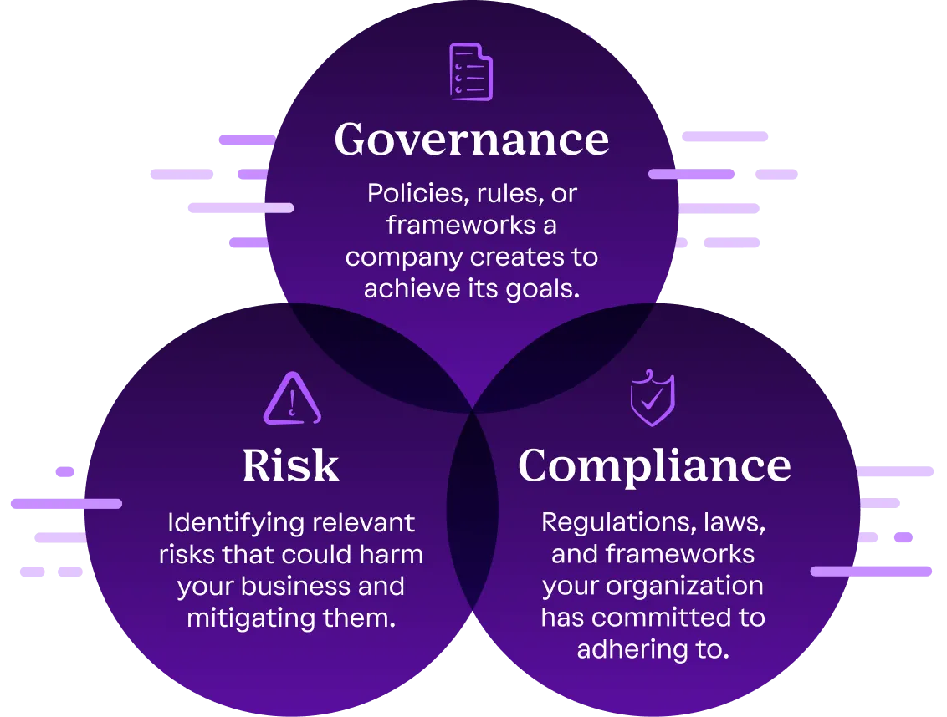
Components of GRC

Slide 108
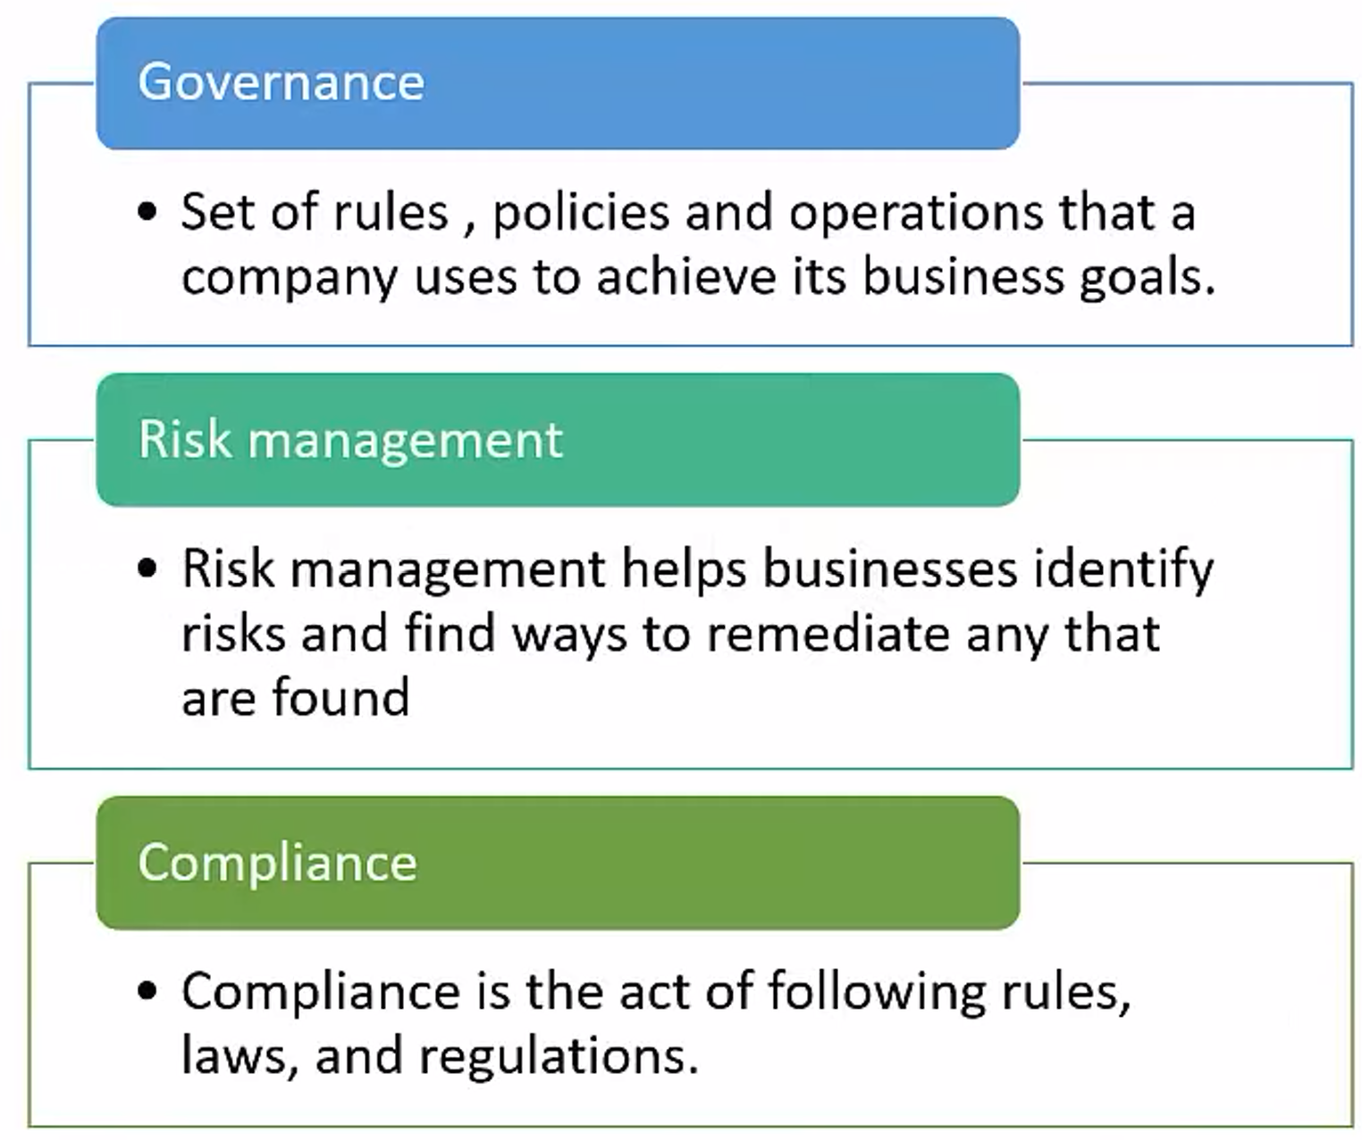
Components of GRC

Slide 109
Why GRC Matters
Growing complexity of regulations, cyber threats, and business operations
Minimizes financial, operational, and reputational risks
Supports strategic decision-making
Reduces costs through unified processes.
Builds stakeholder trust (customers, investors, regulators)

Slide 110
Governance
Governance refers to frameworks, rules, processes, and leadership structures that direct an organization.
Ensures:
  Alignment with mission and vision
  Ethical behavior
  Transparent communication
  Accountability at all levels
Key Components of Governance
  Strategic Planning
  Organizational Structure & Roles
  Policies & Procedures
  Performance Measurement & KPIs
  Decision-Making Frameworks
  Internal Controls
  Stakeholder Communication & Reporting

Slide 111
Objectives of Good Governance
  Improve organizational effectiveness
  Ensure responsibility and accountability
  Facilitate compliance with laws and ethics
  Enable sustainable growth
  Enhance transparency and trust

Slide 112
Risk Management
A systematic process of identifying, assessing, and controlling risks that may impact organizational objectives.
Involves:
  Identifying threats/opportunities
  Measuring likelihood + impact
  Implementing mitigation measures
Types of Risks
  Strategic Risks (market changes, competition)
  Operational Risks (process failures, human error)
  Financial Risks (liquidity, credit issues)
  Cyber/Information Security Risks (breaches, ransomware)
  Compliance/Legal Risks
  Reputational Risks
  Environmental/External Risks

Slide 113
Risk Management Process
  Risk Identification
  Risk Assessment
  Risk Prioritization
  Risk Mitigation
  Monitoring & Review
  Reporting & Communication

Slide 114
Compliance
Ensuring the organization follows all laws, regulations, standards, and internal policies relevant to its operations.
Includes:
  Regulatory compliance
  Industry standards
  Contractual obligations
  Ethical standards & internal policies
Compliance Activities
  Policy creation and enforcement
  Monitoring & audits
  Internal training and awareness
  Reporting violations
  Documentation and evidence collection

Slide 115
How GRC Works Together
Governance sets direction, policies, and accountability for IT operations.
Risk Management identifies and mitigates threats that could impact IT assets and services.
Compliance ensures adherence to laws, standards, and internal controls.
Together, they create a coherent security posture, reduce operational gaps, and ensure regulated, predictable, and resilient IT environments.
Integration enables continuous monitoring, faster decision-making, and reduced security and regulatory failures.

Slide 116
GRC in an Organization’s Information Security Program
1. Governance – Setting Direction & Rules:
Example: A company’s leadership creates an Information Security Policy that states:
  All employee devices must use strong passwords
  Sensitive data must be encrypted
  Only authorized staff can access customer information
This policy provides direction, structure, and expectations for how security should function across the organization.
2. Risk Management – Identifying and Handling Security Threats
Example: The security team identifies a risk:
Employees may fall for phishing emails, leading to data breaches.
They assess the risk and decide to:
  Conduct phishing-awareness training
  Enable email filtering
  Implement multi-factor authentication (MFA)
This shows how the organization identifies, evaluates, and mitigates risks to protect its assets.

Slide 117
GRC in an Organization’s Information Security Program
3. Compliance – Following Laws, Standards, and Policies
Example:
The company must comply with ISO 27001 requirements.
To do this, they:
  Maintain audit logs
  Protect customer data
  Perform regular security audits
  Document processes and controls
Compliance ensures the organization meets legal obligations, industry standards, and its own internal policies.
🎯 Putting It Together (Integrated Example)
A company’s leaders set security policies (Governance), the security team identifies and fixes vulnerabilities (Risk Management), and the organization ensures it follows laws and standards like ISO 27001 (Compliance).
Together, this creates a secure, trustworthy, and well-regulated information security environment.

Slide 118
Importance of GRC in Information Security
Aligns security with business goals: Ensures security initiatives support organizational strategy.
Identifies and reduces risks: Structured risk assessments help prevent data breaches, cyberattacks, and system failures.
Ensures regulatory compliance: Helps meet standards like ISO 27001, NIST, PCI-DSS, GDPR, reducing penalties and legal exposure.
Enhances security governance: Establishes clear policies, accountability, and decision-making structures.
Improves incident response: Integrated controls enable faster detection, reporting, and mitigation of security events.
Supports continuous monitoring: Ensures ongoing evaluation of controls, vulnerabilities, and compliance gaps.
Strengthens stakeholder trust: Demonstrates commitment to protecting information assets.
Notes:
ISO 27001: International Organization for Standardization
NIST Cybersecurity Framework: National Institute of Standards and Technology Cybersecurity Framework
COBIT: Control Objectives for Information and Related Technologies
SP 800-53: NIST Special Publication 800-53

Slide 119
Principles of security audits and assurance
Security Audit:
  A Specific Event. A formal, point-in-time examination.
  Focus: Independently verifying and validating controls against a specific standard or framework (e.g., ISO 27001, NIST).
  Output: A formal report with findings and evidence.
  Analogy: The annual medical check-up with a doctor
Security Assurance:
  The Ongoing Process. A broad, continuous program of activities.
  Focus: Building confidence that security controls are effective over time.
  Includes: Design reviews, risk assessments, training, monitoring.
  Analogy: The daily diet and exercise for good health.
Together, they verify effectiveness, compliance, and resilience of security controls.
Notes:
Security audits validate compliance, control effectiveness, and risk readiness
Assurance provides continuous confidence in the security posture

Slide 120
Why Are Security Audits Essential?
Verify Compliance: Demonstrate adherence to laws, regulations, and contractual obligations (e.g., GDPR, SOX, PCI-DSS).
Identify Vulnerabilities: Uncover weaknesses in systems, processes, and controls before they are exploited.
Manage Third-Party Risk: Assess the security of partners and vendors.
Build Trust & Confidence: Provide assurance to customers, investors, and management.

Slide 121
Roles and responsibilities in audits
Audit Team (Internal/External Auditors): Conducts independent evaluations of controls, processes, and compliance to identify gaps and risks.
Management: Provides resources, supports the audit process, and ensures remediation of audit findings.
IT & Security Teams: Supplies technical evidence, demonstrates control implementation, and assists in resolving identified issues.
Process Owners: Explain business workflows, provide process-related documentation, and maintain effective operational controls.
Risk & Compliance Teams: Interpret requirements, map controls to regulations, and track remediation to maintain compliance posture.
Executive Leadership / Audit Committee: Oversees audit activities, reviews major findings, and ensures accountability and resource allocation.
Notes:
“Map controls to regulations” means matching the security controls implemented by the organization to the specific requirements of laws, standards, and regulations.

Slide 122
Introduction to audit frameworks,
Audit frameworks are structured, standardized methodologies that guide how audits are planned, conducted, and evaluated. They provide a consistent, repeatable, and objective approach to assessing an organization’s controls, policies, risks, and compliance posture.
Audit frameworks are essential because they:
  Ensure uniformity and reliability in audit results
  Align audits with industry best practices and regulatory requirements
  Improve accuracy, transparency, and accountability
  Support organizations in identifying gaps and strengthening their security posture
  Provide benchmark criteria for certifications and compliance assessments
Common audit frameworks include ISO 27001, NIST Cybersecurity Framework, COBIT, SP 800-53
Notes:
ISO 27001: International Organization for Standardization
NIST Cybersecurity Framework: National Institute of Standards and Technology Cybersecurity Framework
COBIT: Control Objectives for Information and Related Technologies
SP 800-53: NIST Special Publication 800-53

Slide 123
ISO 27001
ISO 27001 is an international standard that specifies the requirements for an Information Security Management System (ISMS). It provides a framework for organizations to manage, monitor, and improve the security of their information assets by ensuring the confidentiality, integrity, and availability of information..
It is a globally recognized standard that provides a framework for
  Building
  Implementing
  Maintaining,
  Improving
an organization’s information security management system.

Slide 124
Key Points About ISO 27001
Purpose: Protect confidentiality, integrity, and availability of information.
Scope: Applies to people, processes, technology, and physical security.
Risk-Based: Requires organizations to identify and treat security risks systematically.
Mandatory Documents: Policies, procedures, risk assessment reports, control implementation evidence.
Annex A Controls: Contains 93 security controls categorized into themes such as access control, physical security, operations security, encryption, supplier management, and incident management.
Certification: Organizations can get certified through accredited auditors to prove their security maturity.
Notes:
Control implementation evidence is the proof that a security control is actually implemented and working as intended.
It includes documents, logs, screenshots, reports, configurations, or records that show a control—like access restrictions, backups, encryption, or monitoring—is properly applied and functioning in the organization.

Slide 125
Why ISO 27001 is Important
Ensures structured, standardized security practices
Builds customer trust
Helps meet legal and regulatory requirements
Reduces risk of breaches and cyber incidents
Supports continuous improvement of security posture

Slide 126
NIST SP 800-53
NIST SP 800-53 stands for National Institute of Standards and Technology Special Publication 800-53.
It provides a comprehensive catalog of security and privacy controls designed to protect U.S. federal information systems, but it is widely used by private organizations globally to strengthen cybersecurity programs.
Security and privacy controls are the safeguards, rules, and mechanisms an organization puts in place to protect information, systems, and user data from threats, misuse, and unauthorized access.
Notes:
ISO 27001 focuses on the overall ISMS and risk management, while NIST 800-53 provides detailed, technical controls for specific systems.

Slide 127
NIST SP 800-53 - Key Points
Purpose: To provide a standardized set of security and privacy controls to ensure confidentiality, integrity, and availability of information systems.
Scope: Applies to federal agencies, contractors, and organizations seeking strong security baselines.
Control Families: Controls are organized into categories such as Access Control, Audit & Accountability, Incident Response, Risk Assessment, System & Communications Protection, etc.
Risk-Based: Supports selecting and tailoring controls based on risk and system impact level (Low, Moderate, High).

Slide 128
COBIT
COBIT stands for Control Objectives for Information and Related Technologies.
It is a globally recognized IT governance and management framework developed by ISACA that helps organizations ensure that IT processes align with business goals, manage risks effectively, and meet regulatory requirements.
COBIT is a framework for IT governance and management that focuses on aligning IT with business goals and managing the entire IT landscape, rather than just security.
An IT governance and management framework is a structured set of policies, processes, roles, and best practices that help an organization ensure its IT systems support business goals, operate efficiently, manage risks, and comply with regulations.

Slide 129
COBIT - Key Points
Purpose: To provide a structured framework for governing and managing enterprise IT.
Scope: Covers security, risk, compliance, performance, value delivery, and IT operations.
Domains: COBIT 2019 organizes practices into focus areas such as Governance, Risk Management, Information Security, Compliance, and Performance Management.
Principles-Based: Uses governance and management objectives to help organizations build a holistic IT governance system.

Slide 130
Implementing GRC policies
Define governance structure and policies
Conduct risk assessments and maintain a risk register
Map and implement compliance requirements
Document procedures and assign responsibilities
Train employees and enforce controls
Continuously monitor, audit, and improve
Notes:
A Risk Register is a centralized document that lists all identified risks, along with their likelihood, impact, risk level, owners, and the actions taken to mitigate them.
Document procedures and assign responsibilities means writing down step-by-step instructions for how security processes should be carried out (e.g., how to back up data, how to respond to incidents) and clearly defining who is responsible for performing each task.

Slide 131
GRC Policy Implementation for ISO 27001
1. Governance Implementation: Governance ensures direction, accountability, and structure for the ISMS.
Develop core policies:
  Information Security Policy
  Access Control Policy
  Acceptable Use Policy
  Asset Management Policy
2. Risk Management Implementation: Risk Management ensures the ISMS is risk-based, as required by ISO 27001.
  Conduct a formal risk assessment using qualitative or semi-quantitative methods.
  Identify threats, vulnerabilities, and impacts on information assets.
  Maintain a Risk Register listing risks, owners, controls, and treatment plans.
  Choose controls from Annex A (93 controls) based on risk results.
  Document risk treatment plans and residual risk acceptance.
3. Compliance Implementation: Compliance ensures the organization meets ISO 27001 requirements and any legal or regulatory obligations.
  Map existing controls to ISO 27001 Annex A requirements.
  Implement procedures and SOPs that support the policies.
  Maintain evidence: logs, reports, audit trails, meeting minutes, training records.
  Perform internal ISMS audits to identify gaps before the external audit.
  Conduct management review meetings and track corrective actions (CAPA).
Notes:
Annex A = List of security controls.
Annex B = Informative guidance (not controls, not mandatory).

Slide 132
GRC Essentials for ISO 27001 Audit Readiness
Policies to Implement Before the Audit
Information Security Policy (Governance): Defines security objectives, responsibilities, and accountability across the organization.
Risk Management Policy & Risk Register (Risk Management): Outlines how risks will be identified, assessed, treated, and monitored as required by ISO 27001.
Compliance & Documentation Management Policy (Compliance): Ensures all ISO 27001 controls, evidence, procedures, and records are properly maintained and audit-ready.

Slide 133
Importance of GRC in Preparing for an Audit
A strong Governance, Risk Management, and Compliance (GRC) framework is essential for audit readiness because it provides the structure, controls, documentation, and accountability an auditor expects. Effective GRC:
1. Ensures Clear Governance: Establishes policies, roles, and responsibilities, helping auditors see who owns which processes.
2. Strengthens Risk Management: Provides documented risk assessments, risk registers, and treatment plans, showing the organization understands and manages its security risks.
3. Improves Compliance: Ensures the organization follows required laws, standards, and internal policies.
4. Enhances Documentation & Control Evidence: GRC frameworks ensure procedures, logs, records, and reports are properly maintained and easily accessible for auditors.
5. Supports Continuous Monitoring: Helps track control performance, incidents, corrective actions, and improvements.
6. Provides Accountability and Transparency: Clarifies who performs, approves, and reviews security tasks.

Slide 134
Case Study: Adoption of GRC & ISO 27001 at GLA University IT environment
GLA University manages large volumes of sensitive information, including student records, staff data, financial transactions, research documents, and digital learning systems.
With increasing cyber threats and the shift toward online platforms (ERP, LMS, online admissions), the university identified the need for a standardized security framework.
Problem
Before adopting GRC and ISO 27001, GLA University faced several challenges:
  No centralized governance for IT and security decisions
  Inconsistent policies and procedures across departments
  Risks like unauthorized access, data leakage, and phishing attempts
  Compliance gaps in data protection and documentation
  Difficulty demonstrating security readiness during external audits and accreditation visits
These gaps highlighted the need for a formal ISMS (Information Security Management System) based on ISO 27001.

Slide 135
Cont…
Framework Adoption Approach
1. Implementing Governance (G)
The University created an Information Security Steering Committee involving IT, Academics, Finance, and Administration.
Developed core security policies:
  Information Security Policy
  Data Protection Policy
  Access Control Policy
  Email & Internet Use Policy
Defined roles such as CISO, IT Security Officer, and Data Owners.
Impact: Clear accountability and structured decision-making for security-related activities.

Slide 136
Cont…
2. Implementing Risk Management (R)
Conducted a university-wide risk assessment covering ERP, LMS, Wi-Fi networks, research data, and examination systems.
Identified key risks:
  Weak passwords by students/staff
  Unauthorized access to ERP
  Data loss due to system failures
  Malware infections in labs
Created a Risk Register and applied treatment actions such as MFA, encryption, network segmentation, and awareness training.
Impact: Prioritized risk areas and implemented appropriate ISO 27001 Annex A controls.

Slide 137
Cont…
3. Implementing Compliance (C)
Mapped controls to ISO 27001 requirements (e.g., access control, asset management, physical security).
Maintained documentation such as:
  SOPs for data access
  Incident management procedures
  Backup and recovery logs
  Asset lists and user access reviews
Conducted internal audits and fixed non-conformities.
Impact: Improved compliance posture and readiness for accreditation and external audits.

Slide 138
Cont…
ISO 27001 ISMS Implementation Steps
GLA University followed a structured approach:
  Define ISMS scope (ERP, LMS, data centers, examination systems).
  Conduct risk assessment and select Annex A controls.
  Implement technical controls – MFA, firewalls, backups, antivirus, encryption.
  Implement administrative controls – training, policies, procedures.
  Internal audit and management review meetings.
  Corrective actions for non-conformities.
  Prepare for external ISO 27001 audit.

Slide 139
Cont…
Outcomes
Security Improvements
Stronger access control across ERP and LMS
Fewer incidents of phishing and malware due to training
Better documentation and control evidence for audits
Operational Improvements
Clear governance and responsibilities
Streamlined processes across departments
Faster response to incidents and vulnerabilities
Compliance Benefits
Alignment with ISO 27001:2022
Increased trust among students, staff, and regulatory bodies
Preparedness for NAAC, NBA, and external accreditation audits

Slide 140
Risk Identification Techniques
a) Brainstorming
  Team members discuss possible risks based on experience and knowledge.
  Useful for generating a broad list of risks quickly.
b) Interviews & Questionnaires
  One-on-one discussions with process owners, IT teams, or managers.
  Helps uncover hidden or process-specific risks.
c) Checklists
  Use predefined lists of common risks or control requirements (e.g., ISO 27001 Annex A, NIST controls).
  Ensures no major areas are missed.
d) Asset Inventory & Threat Analysis
  Identify critical assets (data, systems, people) and examine what threats apply to each.
  Used heavily in ISO 27001.
e) Past Incident Reviews
Analyze previous breaches, outages, and audit findings to identify recurring risks.

Slide 141
Risk Assessment Techniques
These methods help evaluate the likelihood and impact of identified risks to determine their severity and priority.
a) Qualitative Risk Assessment
  Uses descriptive values like Low / Medium / High.
  Easy to understand and commonly used in ISO 27001.
b) Quantitative Risk Assessment
  Assigns numeric values (e.g., financial loss, probability percentages).
  Useful for calculating risk in measurable terms.
c) Semi-Quantitative Assessment
  Combines qualitative categories with scoring (e.g., 1–5 scale).
  Balances simplicity and precision.
d) Risk Matrix (Probability–Impact Matrix)
  Plots risks on a grid to visualize severity.
  Helps prioritize which risks need immediate action.
  High Probability + High Impact → Critical Risk (immediate action needed)
  Low Probability + Medium Impact → Moderate Risk (monitor)
  Low Probability + Low Impact → Low Risk (acceptable)

Slide 142
Qualitative vs. Quantitative Risk Analysis
Aspect | Qualitative Analysis | Quantitative Analysis
Basis | Judgment, experience | Numerical data, statistics
Output | High/Med/Low | ₹ value, probability
Time Required | Fast | Slow
Accuracy | Moderate | High
Best Used For | General security risks, ISO 27001 | Financial impact modeling
Data Required | Low | High
Decision Support | Qualitative prioritization | Financial justification
Complexity | Simple | Complex

Slide 143
Risk Mitigation Strategies
Risk mitigation is about selecting appropriate actions to reduce risk to an acceptable level.
1. Risk Avoidance: Eliminating the activity that causes the risk.
Example: Discontinue using an outdated software system.
2. Risk Reduction (Mitigation): Implementing controls to reduce likelihood or impact.
Example: Install firewalls, apply patches, enable MFA, encrypt data.
3. Risk Transfer: Shifting the financial impact to a third party.
Example: Cyber insurance, outsourcing services to secure vendors.
4. Risk Acceptance: Accepting the risk because it is within risk appetite or cost of control is too high.
Example: Accepting minor website downtime risk.
5. Risk Sharing: Distributing risk between multiple parties.
Example: Cloud provider and organization share responsibility for data security.
Notes:
A Risk Matrix is a grid that shows each risk based on two factors:
Probability (likelihood) of the risk happening
Impact (severity) if the risk occurs
The risk is within the organization’s risk appetite (i.e., it is considered low enough to tolerate), or
The cost of implementing a control is higher than the potential damage the risk may cause.

